Slide 1

Chapter 17: Economic Growth: Resources, Technology, Ideas and Institutions
© 2014 Cengage Learning. All Rights Reserved. May not be copied, scanned, or duplicated, in whole or in part, except for use as permitted in a license distributed with certain product , service, or otherwise on password-protected website for classroom use

Slide 2

In This Lecture…
Economic Growth
The Production Function
The Production Function and Economic Growth
New Growth Theory
Economic Growth and Special Interest Groups
To select a topic, click on its link above
© 2014 Cengage Learning. All Rights Reserved. May not be copied, scanned, or duplicated, in whole or in part, except for use as permitted in a license distributed with certain product , service, or otherwise on password-protected website for classroom use

Slide 3
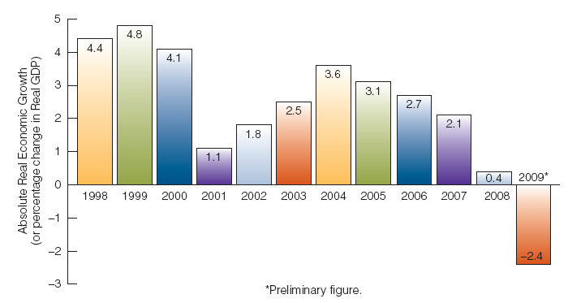
Absolute Real Economic
Growth
An increase in Real GDP from one period to the next.
Absolute Real Economic Growth Rates for the United States, 1998-2009
Click to return to “In this Lesson”
© 2014 Cengage Learning. All Rights Reserved. May not be copied, scanned, or duplicated, in whole or in part, except for use as permitted in a license distributed with certain product , service, or otherwise on password-protected website for classroom use

Slide 4
Per Capita Real Economic
Growth
An increase from one period to the next in per capita Real GDP, which is Real GDP divided by population.
Per capita Real GDP = Real GDP/Population
Click to return to “In this Lesson”
© 2014 Cengage Learning. All Rights Reserved. May not be copied, scanned, or duplicated, in whole or in part, except for use as permitted in a license distributed with certain product , service, or otherwise on password-protected website for classroom use

Slide 5
Economic Growth
Click photo above to view a tutorial on economic growth
Click to return to “In this Lesson”
© 2014 Cengage Learning. All Rights Reserved. May not be copied, scanned, or duplicated, in whole or in part, except for use as permitted in a license distributed with certain product , service, or otherwise on password-protected website for classroom use

Slide 6
Production Function
A function that specifies the relation between technology and the quantity of factor inputs to output or Real GDP.
Real GDP = T (L, K)
The L stands for labor; the K stands for capital; the T stands for the technology coefficient.
Click to return to “In this Lesson”
© 2014 Cengage Learning. All Rights Reserved. May not be copied, scanned, or duplicated, in whole or in part, except for use as permitted in a license distributed with certain product , service, or otherwise on password-protected website for classroom use

Slide 7
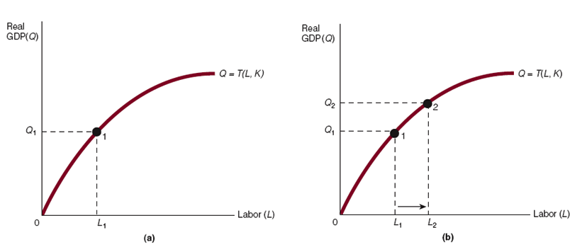

Production Function
The production function is based on labor (L), capital (K), and technology (technology coefficient, T).
Changes in L lead to changes in Real GDP (Q).
Click to return to “In this Lesson”
© 2014 Cengage Learning. All Rights Reserved. May not be copied, scanned, or duplicated, in whole or in part, except for use as permitted in a license distributed with certain product , service, or otherwise on password-protected website for classroom use

Slide 8
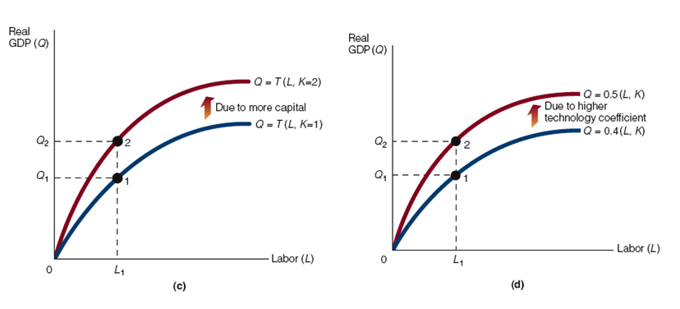
Production Function
c) A rise in capital leads to a shift upward in the production function and to more Real GDP (for a given level of L and a given technology coefficient).
d) A rise in the technology coefficient leads to a shift upward in the production function and to more Real GDP (for a given level of L and K).
Click to return to “In this Lesson”
© 2014 Cengage Learning. All Rights Reserved. May not be copied, scanned, or duplicated, in whole or in part, except for use as permitted in a license distributed with certain product , service, or otherwise on password-protected website for classroom use

Slide 9
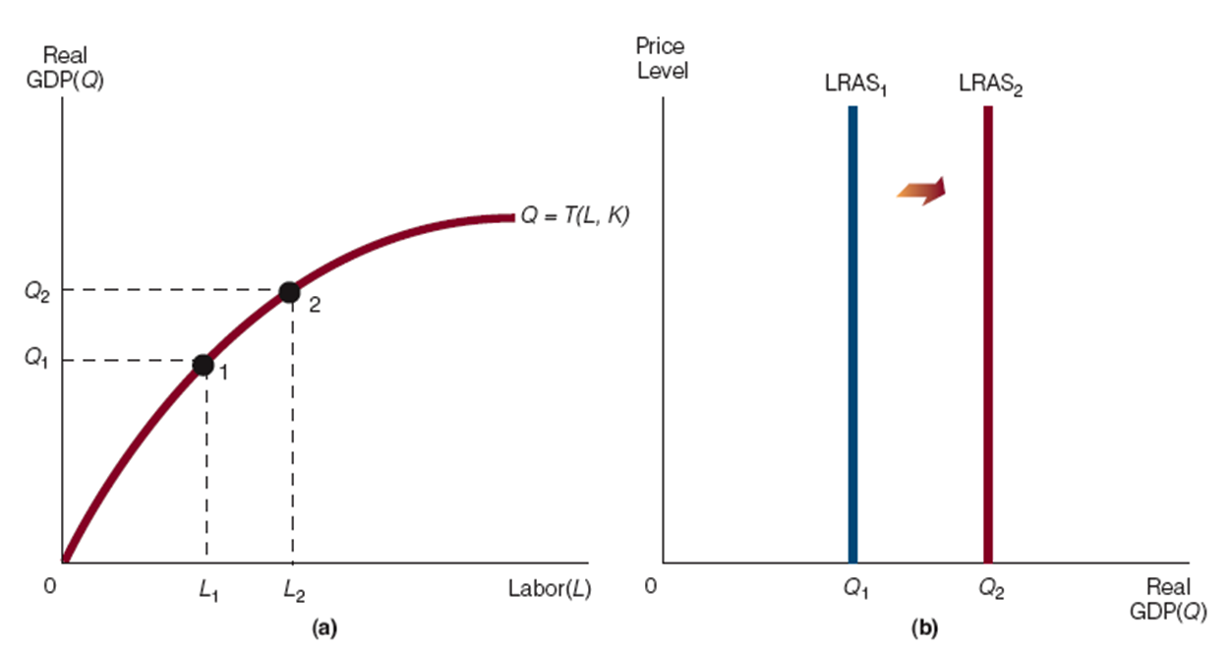
The Production Function and the LRAS Curve
(a) More labor (L) leads to more Real GDP (shown in terms of the production function.
(b) More L shifts the LRAS curve to the right.
Click to return to “In this Lesson”
© 2014 Cengage Learning. All Rights Reserved. May not be copied, scanned, or duplicated, in whole or in part, except for use as permitted in a license distributed with certain product , service, or otherwise on password-protected website for classroom use

Slide 10
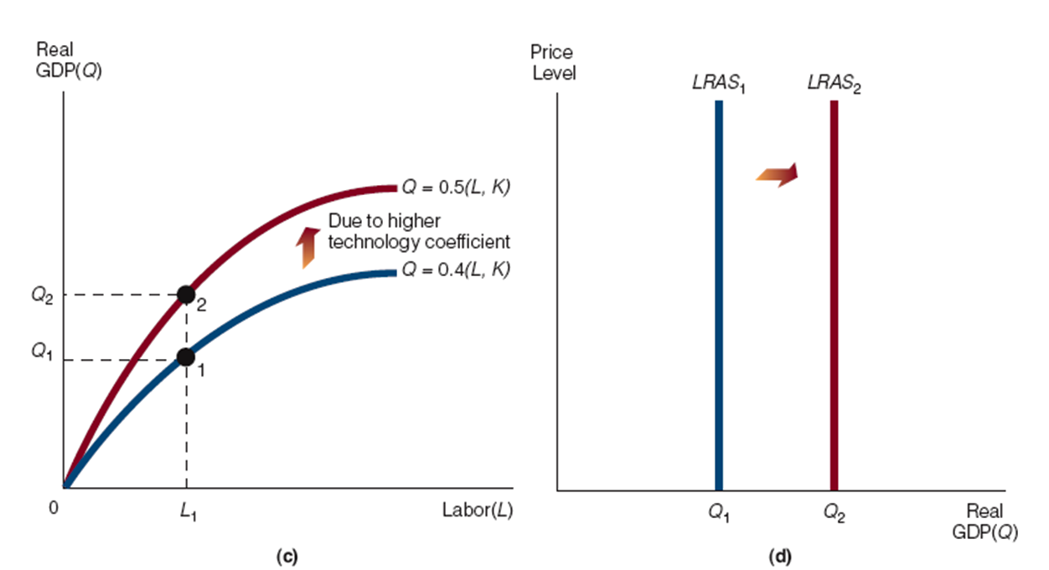
The Production Function and the LRAS Curve
(c) A higher technology coefficient shifts the production function up and brings about more Real GDP, Q. (d) A heightened technology coefficient leads to a rightward shift in the LRAS curve. (Although not shown in this exhibit, a rise in K would do the same thing as a rise in the technology coefficient in terms of shifting up the production function and shifting the LRAS curve to the right.)
Click to return to “In this Lesson”
© 2014 Cengage Learning. All Rights Reserved. May not be copied, scanned, or duplicated, in whole or in part, except for use as permitted in a license distributed with certain product , service, or otherwise on password-protected website for classroom use

Slide 11
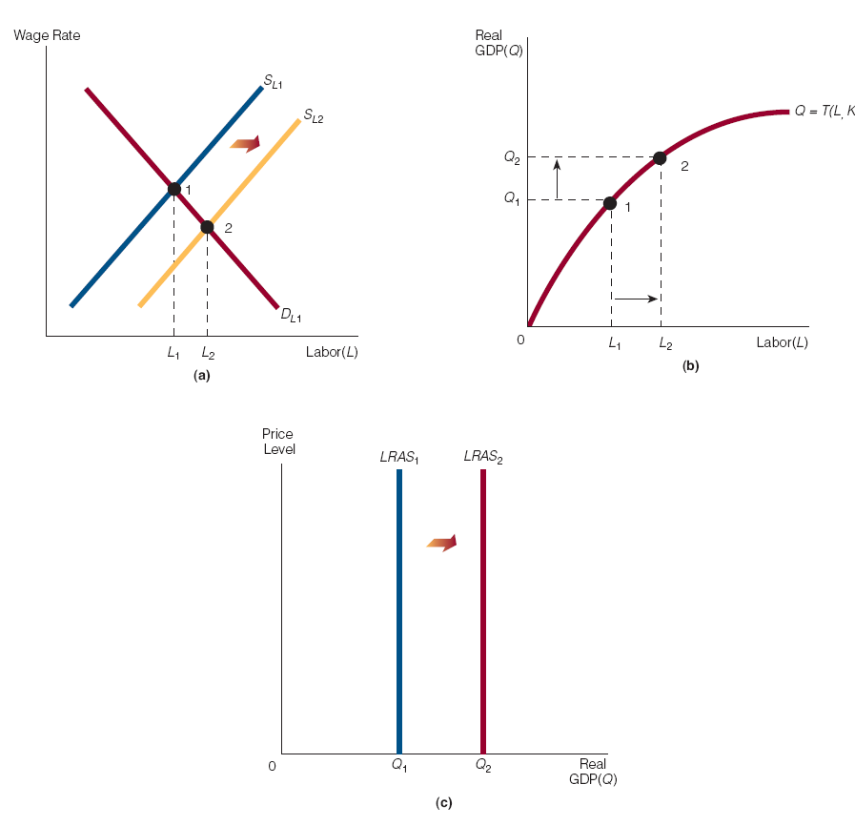
Labor markets, the Production Function, and the LRAS Curve
( a) Lower taxes on income shifts the labor supply curve rightward from SLF1 to SLF2.
As a result of the lower taxes and the shift rightward in the labor supply curve, the equilibrium amount of labor rises from L1 to L2. (b)
More labor leads to more Real GDP in terms of the production function. (c) More Real GDP corresponds to a rightward shift in the LRAS curve.
Click to return to “In this Lesson”
© 2014 Cengage Learning. All Rights Reserved. May not be copied, scanned, or duplicated, in whole or in part, except for use as permitted in a license distributed with certain product , service, or otherwise on password-protected website for classroom use

Slide 12
Determinants of Economic Growth
Natural Resources
Labor
Capital Technological Advances
Free Trade
Property Rights Structure
Economic Freedom
Policies to Promote Economic Growth
Click to return to “In this Lesson”
© 2014 Cengage Learning. All Rights Reserved. May not be copied, scanned, or duplicated, in whole or in part, except for use as permitted in a license distributed with certain product , service, or otherwise on password-protected website for classroom use

Slide 13
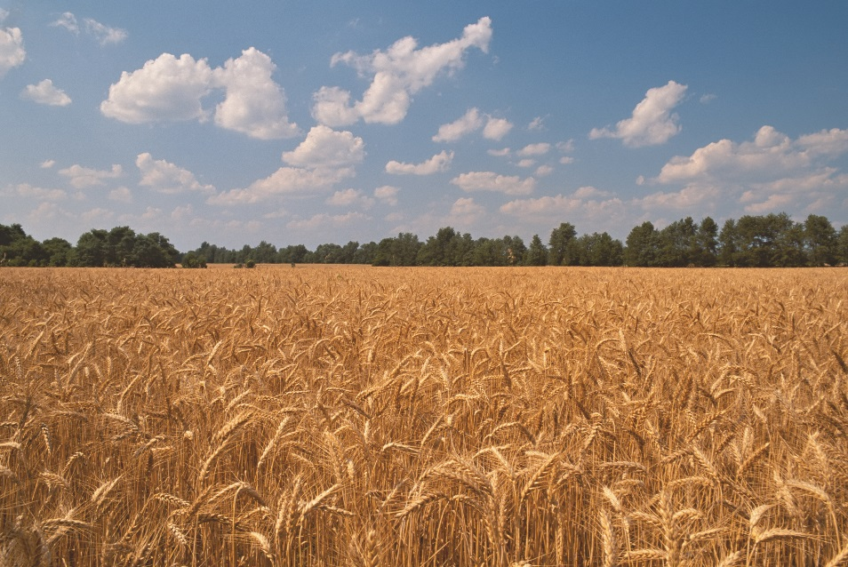
Natural Resources
Land - All natural resources, such as minerals, forests, water, and unimproved land
Click to return to “In this Lesson”
© 2014 Cengage Learning. All Rights Reserved. May not be copied, scanned, or duplicated, in whole or in part, except for use as permitted in a license distributed with certain product , service, or otherwise on password-protected website for classroom use

Slide 14

Labor
The physical and mental talents people contribute to the production process
Click to return to “In this Lesson”
© 2014 Cengage Learning. All Rights Reserved. May not be copied, scanned, or duplicated, in whole or in part, except for use as permitted in a license distributed with certain product , service, or otherwise on password-protected website for classroom use

Slide 15
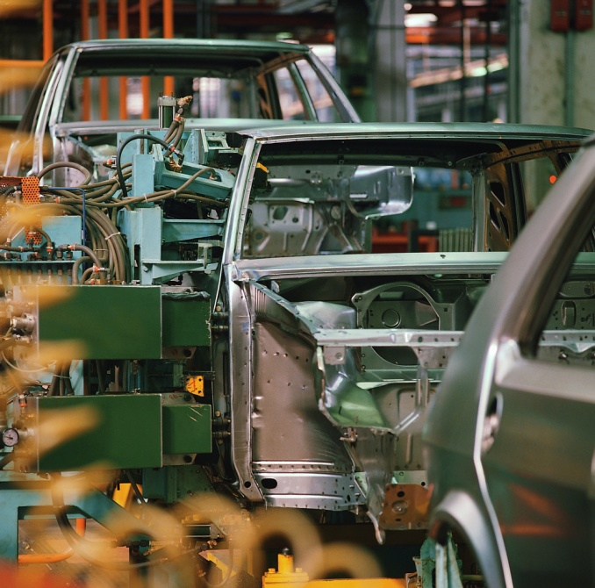
Capital
Produced goods that can be used as inputs for further production, such as factories, machinery, tools, computers, and buildings
Click to return to “In this Lesson”
© 2014 Cengage Learning. All Rights Reserved. May not be copied, scanned, or duplicated, in whole or in part, except for use as permitted in a license distributed with certain product , service, or otherwise on password-protected website for classroom use

Slide 16

Human Capital
The knowledge and skills a person acquires through education, training, and experience.
Click to return to “In this Lesson”
© 2014 Cengage Learning. All Rights Reserved. May not be copied, scanned, or duplicated, in whole or in part, except for use as permitted in a license distributed with certain product , service, or otherwise on password-protected website for classroom use

Slide 17

Technological Advances
An advance in technology commonly refers to the ability to produce more output with a fixed amount of resources or the ability to produce the same output with fewer resources.
Click to return to “In this Lesson”
© 2014 Cengage Learning. All Rights Reserved. May not be copied, scanned, or duplicated, in whole or in part, except for use as permitted in a license distributed with certain product , service, or otherwise on password-protected website for classroom use

Slide 18

Free Trade
Free trade among countries allows each to produce goods in which they have a comparative advantage (The situation where someone can produce a good at lower opportunity cost than someone else can).
Click to return to “In this Lesson”
© 2014 Cengage Learning. All Rights Reserved. May not be copied, scanned, or duplicated, in whole or in part, except for use as permitted in a license distributed with certain product , service, or otherwise on password-protected website for classroom use

Slide 19

Property Rights Structure
Some economists have argued that per capita real economic growth first appeared in areas that had developed a system of institutions and property rights that encouraged individuals to direct their energies to effective and creative economic projects.
Click to return to “In this Lesson”
© 2014 Cengage Learning. All Rights Reserved. May not be copied, scanned, or duplicated, in whole or in part, except for use as permitted in a license distributed with certain product , service, or otherwise on password-protected website for classroom use

Slide 20

Economic Freedom
Countries in which people enjoy a large degree of economic freedom develop and grow more quickly than countries in which people have little economic freedom.
Click to return to “In this Lesson”
© 2014 Cengage Learning. All Rights Reserved. May not be copied, scanned, or duplicated, in whole or in part, except for use as permitted in a license distributed with certain product , service, or otherwise on password-protected website for classroom use

Slide 21

Policies to Promote Economic Growth
Tax Policy – lower taxes on wages; lower taxes on investment income;
Regulatory Policy – lower costs of compliance with regulations
Industrial Policy – A deliberate policy by which government “waters the green spots,” or aids industries that are most likely to be successful in the world marketplace.
Click to return to “In this Lesson”
© 2014 Cengage Learning. All Rights Reserved. May not be copied, scanned, or duplicated, in whole or in part, except for use as permitted in a license distributed with certain product , service, or otherwise on password-protected website for classroom use

Slide 22
New Growth Theory I
New growth theory holds that technology is endogenous* as opposed to neoclassical growth theory, which holds that technology is exogenous*.
More important, the amount and quality of technology that is developed depend on the amount of resources we devote to it: The more resources that go to develop technology, the more and better technology that is developed.
*When something is endogenous, it is part of the economic system, under our control or influence. When something is exogenous, it is not part of the system; it is assumed to be given to us, often mysteriously through a process that we do not understand.
Click to return to “In this Lesson”
© 2014 Cengage Learning. All Rights Reserved. May not be copied, scanned, or duplicated, in whole or in part, except for use as permitted in a license distributed with certain product , service, or otherwise on password-protected website for classroom use

Slide 23

New Growth Theory II
According to Paul Romer, discovering and implementing new ideas are what causes economic growth.
Certain institutions can promote the discovery of new ideas and therefore promote economic growth.
Click to return to “In this Lesson”
© 2014 Cengage Learning. All Rights Reserved. May not be copied, scanned, or duplicated, in whole or in part, except for use as permitted in a license distributed with certain product , service, or otherwise on password-protected website for classroom use

Slide 24
New Growth Theory III
Romer has argued said that “economic growth occurs whenever people take resources and rearrange them in ways that are more valuable.”
Let’s focus on the word “rearrange.” We can think of rearranging as in rearranging the pieces of a puzzle, as in changing the ingredients in a recipe, or as in rearranging the way workers go about their daily work.
When we rearrange anything, we do that “thing” differently. Sometimes, differently is better, and sometimes it is worse.
Click to return to “In this Lesson”
© 2014 Cengage Learning. All Rights Reserved. May not be copied, scanned, or duplicated, in whole or in part, except for use as permitted in a license distributed with certain product , service, or otherwise on password-protected website for classroom use

Slide 25
Special Interest Groups
According to Mancur Olson, in The Rise and Decline of Nations, special interest groups are more likely to argue for transfer-promoting policies than growth-promoting policies, and the cost–benefit calculation of each policy is the reason.
This behavior affects economic growth in that the more special interest groups there are in a country, the more likely it is that transfer-promoting policies will be lobbied for instead of growth-promoting policies.
Individuals will try to get a larger slice of a constant-sized economic pie rather than trying to increase the size of the pie. In short, numerous and politically strong special interest groups are detrimental to economic growth.
Click to return to “In this Lesson”
© 2014 Cengage Learning. All Rights Reserved. May not be copied, scanned, or duplicated, in whole or in part, except for use as permitted in a license distributed with certain product , service, or otherwise on password-protected website for classroom use

Slide 26
Self-test
1. Explain how a decline in taxes that affects the labor market can end up shifting the LRAS curve to the right.
A decline in taxes shifts the labor supply curve to the right, which increase the equilibrium level of labor in the labor market. More labor generates more output (Real GDP). And more Real GDP is consistent with the LRAS curve having shifted to the right .
Click to return to “In this Lesson”
© 2014 Cengage Learning. All Rights Reserved. May not be copied, scanned, or duplicated, in whole or in part, except for use as permitted in a license distributed with certain product , service, or otherwise on password-protected website for classroom use

Slide 27
Self-test
2. What is the difference between physical and human capital?
Physical capital consists of the produced goods that are used as inputs for further production, such as factories, machinery, tools, computers, and buildings. Human capital refers to the knowledge and skills individuals acquire through education, training, and experience .
Click to return to “In this Lesson”
© 2014 Cengage Learning. All Rights Reserved. May not be copied, scanned, or duplicated, in whole or in part, except for use as permitted in a license distributed with certain product , service, or otherwise on password-protected website for classroom use

Slide 28
Self-test
3. What is the difference between neoclassical growth theory and new growth theory with respect to technology?
In neoclassical growth theory, technology was, in a sense, “just there.” Technological advances just happened, but how these advances happened was not fully understood. Technology was something that was exogenous—outside the economic system and outside of our control. In new growth theory, technology is said to be endogenous. It can be increased or decreased by the amount of resources devoted to it. Also, technology is viewed as being related to ideas .
Click to return to “In this Lesson”
© 2014 Cengage Learning. All Rights Reserved. May not be copied, scanned, or duplicated, in whole or in part, except for use as permitted in a license distributed with certain product , service, or otherwise on password-protected website for classroom use

Slide 29
Self-test
4. In the production function specified in Exhibit 2(a) of the text, what variable(s) are movement factors (will move us along the production function)? What variable(s) are shift factors (will shift the production function)?
Labor is the movement factor, and both capital and the technology coefficient are shift factors .
Click to return to “In this Lesson”
© 2014 Cengage Learning. All Rights Reserved. May not be copied, scanned, or duplicated, in whole or in part, except for use as permitted in a license distributed with certain product , service, or otherwise on password-protected website for classroom use

Slide 30

Wall Street Journal
The Wall Street Journal is a is a rich source of information which provides real life examples of micro- and macro economic activities. Check today’s issue to see the most current news.
http://www.wsj.com
Click to return to “In this Lesson”
© 2014 Cengage Learning. All Rights Reserved. May not be copied, scanned, or duplicated, in whole or in part, except for use as permitted in a license distributed with certain product , service, or otherwise on password-protected website for classroom use

